Slide 1

DEPARTMENT OF ELECTRICAL & ELECTRONICS ENGINEERING SCHOOL OF ELECTRICAL & COMMUNICATION 10214EE601- MINOR PROJECT -II WINTER SEMESTER(2023-2024)
FIRST REVIEW
“DESIGN AND DEVELOPMENT OF PROTOTYPE MODEL OF WAVE GENERATOR WITH SOLAR SYSTEM”
Guided by Dr.K.Karunanithi
Professor / EEE
Presented by:
K.GUHAN VTU20248
S.ADESH VTU19723
M.V.KARTHIKEYA VTU20418

Slide 2
OUTLINE
Abstract
Objectives
Block diagram
Component
Conclusion
References

Slide 3
ABSTRACT
There are many power generating methods available in our nation to meet the power needs. But the resources used to generate are almost fossil fuels and non-renewable energy resources.
Some other power generating methods utilizes the renewable sources to produce electric power. Tidal energy is a form of energy that can be utilized to produce electric power but there is no equipment or machine to utilize the tidal energy and to convert into a useful form of energy our ultimate aim is to design a machine that utilize the tidal energy to produce electric energy.
Some of the renewable energy resources are not available at all time ,solar energy is also a renewable energy but it is not available at all times during nights and windy,rainy seasons the availability of sunlight is very less. But tidal energy is constant at all times so the usage of tidal energy can pave way for constant energy generation.
This machine is designed to utilize the tidal energy to produce electric power.
Our machine is designed such that it can be engaged and disengaged the transfer of machine from one place to another is easy that means the machine is portable.
Number of pedals used to produce more power to ensure the complete utilization of the tidal energy resource.
KEY WORDS:Tidal energy,Wind energy,Pedals

Slide 4
OBJECTIVES
Efficient use of sea waves to generate tidal power
Portable machine for ease of transport
Dual power generation for guaranteed power generation in all climates

Slide 5
BLOCK DIAGRAM
Generator one
Generator
two
Tidel waves
Tidel waves
Rectifier
converter
Battery

Slide 6
COMPONENTS
GENERATOR
SHAFT
MOTOR MOUNTS
Ratching free wheel
Chain and bracket
Fly wheel

Slide 7
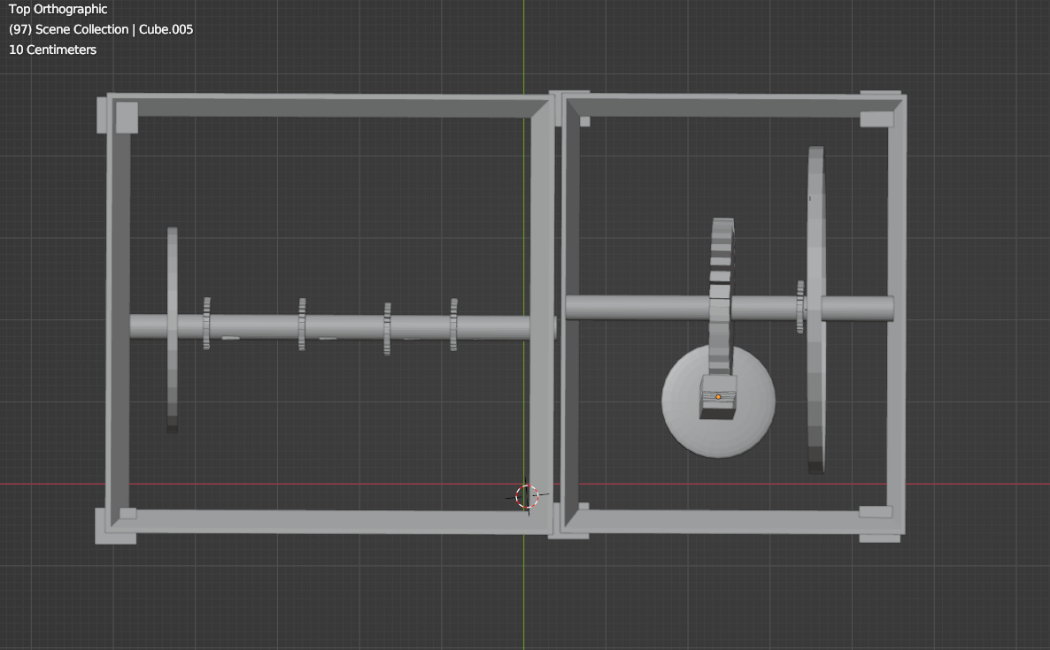
3D -VIEWS
Fig.01-TOP VIEW

Slide 8
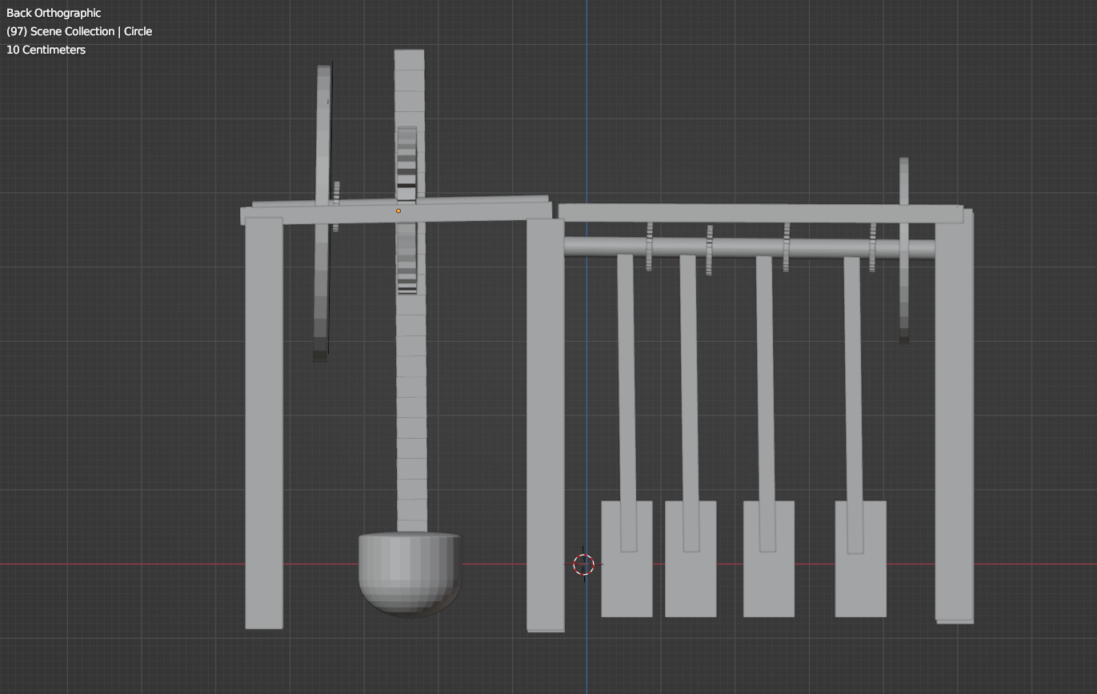
3D -VIEWS
Fig.02- FRONT VIEW

Slide 9
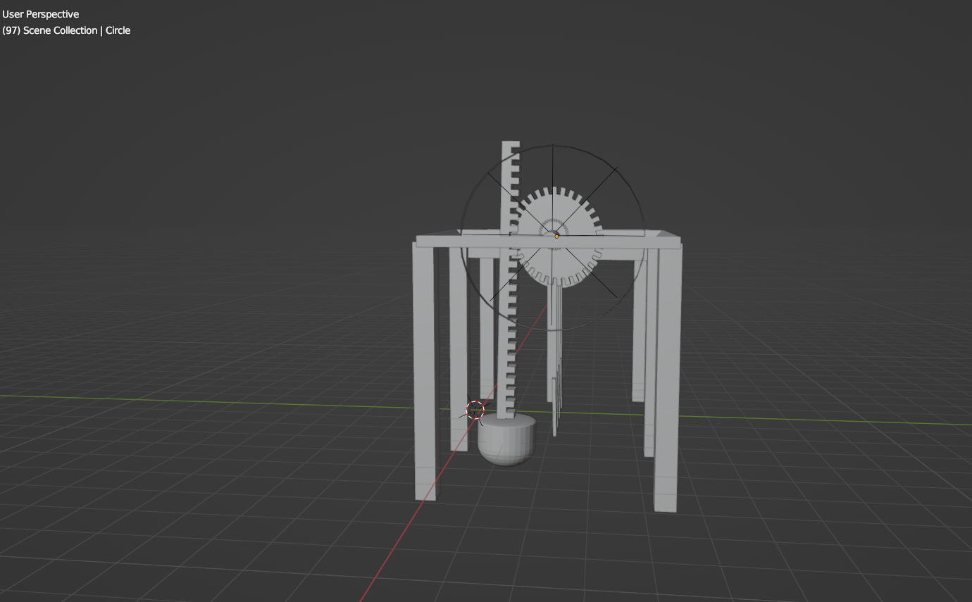
3D -VIEWS
Fig.03- SIDE VIEW

Slide 10
CONCLUSION
With enormous potential to meet the world's energy demands, tidal energy offers a promising renewable energy source. Because of its dependability, predictability, and sustainability, it is a desirable alternative for energy portfolio diversification and for lowering dependency on fossil fuels. There are still a number of obstacles to overcome, though, such as the high initial investment prices, the environmental effects, and the restricted regional appropriateness. Despite these difficulties, technological developments like tidal stream turbines and barrages, together with continuing research into environmental mitigation strategies, provide ways to get around these problems. Tidal energy may also be made more viable and reliable by integrating it with grid networks and hybrid energy systems.
In conclusion, while tidal wave energy generation is still in its early stages of development, it has the potential to play a significant role in the global transition towards sustainable energy sources. With continued investment, innovation, and collaboration, tidal wave energy has the capacity to contribute substantially to the world's energy mix, reducing dependence on fossil fuels and mitigating climate change.

Slide 11
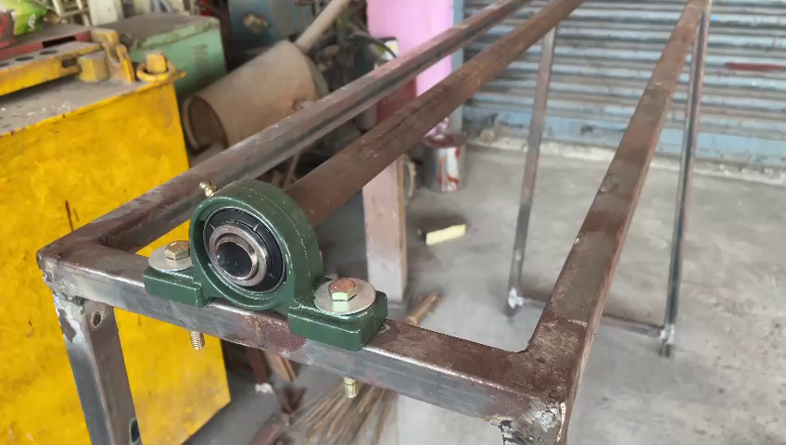
PROJECT VIDEO

Slide 12
TIMELINE PLAN
S.NO | PROJECT ACTIVITY | DESCRIPTION | DATE
1. | ANALYSIS | Prototype rough design and dimension in scaling | 2/2/24
2. | DESIGN | The software which is use to make 3D model is BLENDER | 23/2/24
3. | PURCHACING | components-: Generator, shaft, coupled bearing | 17/3/24
4. | MECHANICAL WORK | weelding and attachment is the process of joining of two or more metal peaces together | 31/3/24
5. | FINAL WORK | painting is a process to protect from corrosion and improve the durabilty of project | 10/4/24
6. | SUBMISSION | project final look | 27/4/24

Slide 13
BUDGET
S.NO | MATERIALS | QUANTITY | AMOUNT
1. | IRON SHAFT | 7feet | 450/-
2. | BEARING COUPLING | 4 | 1200/-
3. | CYCLE DYNOMO | 2 | 1500/-
4. | BIKE CHAIN | 1 | 100/-
5. | FREE WHEEL | 6 | 720/-
6. | FLY WHEEL | 2 | 1500/-
7. | LATHE WORK | Nil. | 400/-
8. | FABRICATION(Adv.) | Nil. | 2000/-
 |  | TOTAL = | ₹ 7,870

Slide 14
REFERENCES
Farley, F. J., & Polagye, B. L. (2016). Theoretical upper limits on energy production by extracting power from ocean waves “This paper discusses the theoretical upper limits of energy production through wave energy extraction, providing valuable insights into the potential of wave energy as a renewable energy source”
Charlier, R. H., & Frangoudes, K. (Eds.). (2016). Tidal Energy from the Bay of Fundy: Moving from Theory to Practice. Springer. “This book explores the practical aspects of harnessing tidal energy, focusing on the Bay of Fundy as a case study. It covers various technological, environmental, and economic considerations associated with tidal energy extraction”
Cruz, J. M., Guanche, R., Carballo, R., & Negro, V. (2017). Overview of wave energy technologies and the RESOR project. In Oceans '17 MTS/IEEE Aberdeen (pp. 1-8). IEEE. “This conference paper provides an overview of wave energy technologies and highlights the RESOR project, which aims to develop innovative solutions for improving the efficiency and reliability of wave energy conversion systems.”

Slide 15
REFERENCES
G. P. Harrison, J. R. Taylor, and D. A. Flin, "Tidal power and its potential in the UK,1996. “This paper provides an overview of tidal power and its potential, focusing specifically on the United Kingdom”
Cruz, J. M., Neumann, F., Sánchez, J., Castro-Santos, L., & De Azevedo, J. (2016). “This review article offers a comprehensive overview of methods and technologies for assessing wave energy, providing valuable insights into the field”
Falnes, Johannes, and Helge Kristiansen. "A review of wave-energy extraction." (2001). “This review paper discusses various methods and technologies for wave-energy extraction, offering insights into the state-of-the-art approaches and challenges in the field”

Slide 16
THANK YOU

